Slide 1
Data Science - Data Collection and Analysis in 15ish Minutes Public Management Research Conference May 25, 2022
Eric Stokan
Assistant Professor, Political Science
Affiliate Faculty, School of Public Policy
University of Maryland, Baltimore County
estokan@umbc.edu

Slide 2
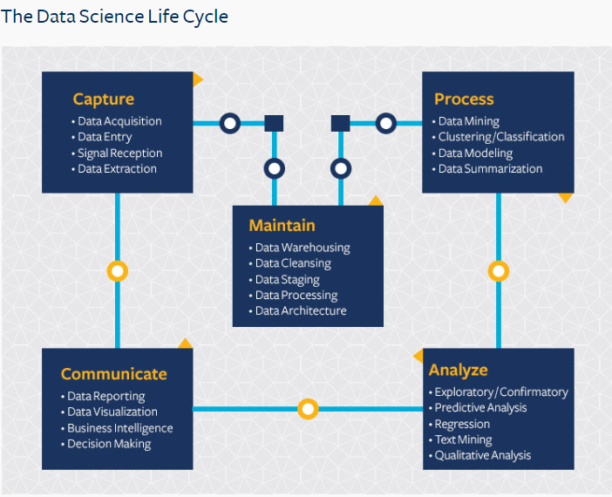
Capture and Curation
Analysis- Machine Learning Models
Interesting Examples from Poli Sci/Pub Admin/Policy
Resources
Why Use Data Science Tools
Source: Berkely School of Information

Slide 3
Why Use Data Science Tools?
New methods and tools
Natural Language Processing
Image Detection
Improve upon existing approaches
Improve classification and prediction tasks
Improve analyses of complex social phenomena (nonlinearities, sparsity, and multidimensional moderating effects)
Ensemble models for improved performance (flexible functional forms)
Productize models flexibly
Couple with traditional research approaches (under different assumptions)
Make clearer issues of overfitting
Robustness checks
Sound Recognition
Handle missing data
Notes:
Why use data science tools?

Slide 4
Capture and Curation
Traditional Approaches
Data Science Approaches
Surveys (Static)
Administrative Data
Website Information Documents/PDFs (Coded By hand)
Structured Experiments
Surveys (Dynamic)
Scrape Websites
Computationally parse PDFs
Extract social media comments
Use images, sound, and other unstructured data

Slide 5
Administer Survey to Local Governments
Include Ideology Question on Survey
Determine Representativeness of Data
Consider issues around Missing Data
Devise Sampling Strategy
Traditional Research Approach

Slide 6
Administer Survey to Local Governments
Include Ideology Question on Survey
Determine Representativeness of Data
Consider issues around Missing Data
Devise Sampling Strategy
Traditional Research Approach
Get Master List of Govt Websites
Create Web-based Crawler to Scrape Data
Filter Out Irrelevant Information
Use Text from Data to Discern Mayor’s Ideology
Determine where Ideology Might be Uniformly Stored*
Data Science Approach
See Neumann, Linder, and Desmarais (2021)

Slide 7
Data Science Process
Benefits
Automated process- can be run following new elections.
Drawbacks
Updating list of URLs
Less certitude (need more verification)
Costly up front
Requires great capacity/programming knowledge
Traditional Research Process
Benefits
Greater certitude data matches reality
Drawbacks
One-off process (Point-in-time)
Costly each time
Representativeness of data (Response as a function of capacity)

Slide 8
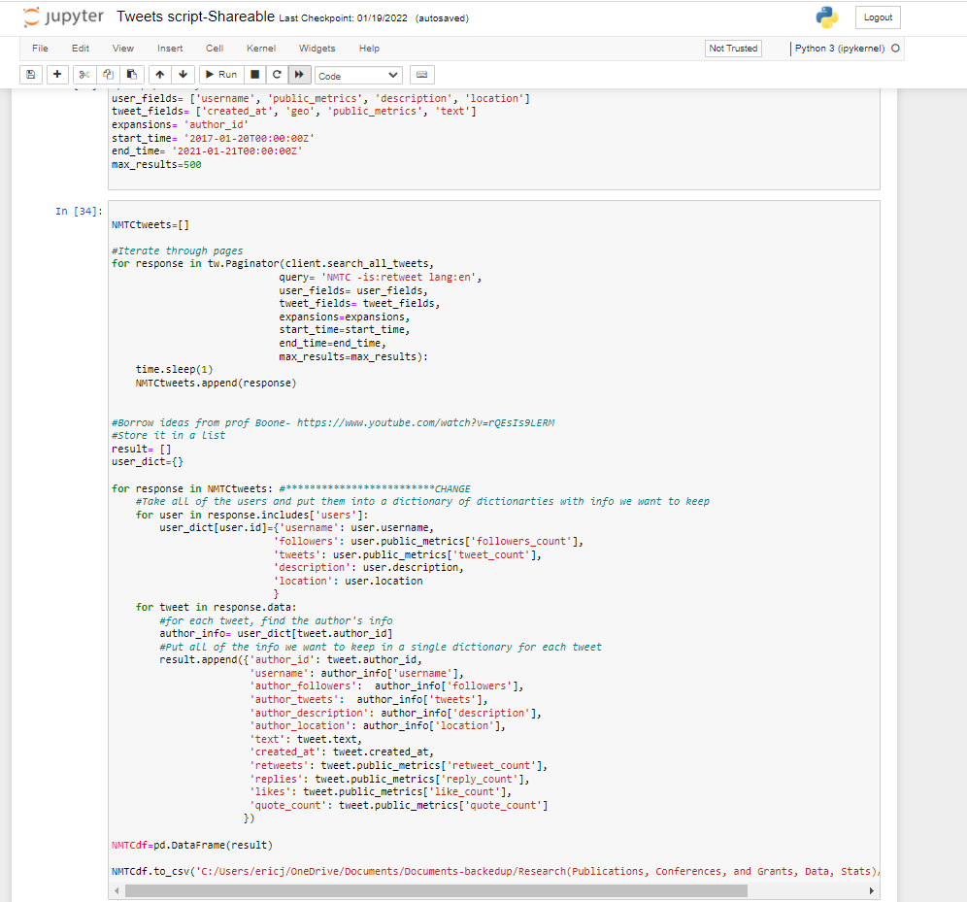
Tweets collected
~2 million Tweets
~600,000 unique users
11 economic development/social policies
Predict botornot
Run on all 600,000 users
Timelines (200 Tweets per- All influencers)
Sentiment analysis on all 2 million Tweets
Sentiment analysis on all timelines from Influencers (~5 million Tweets)
Also, calculated user sentiment mean and SD
Classification
Large number of dictionaries created/found to start classifying users by their point in the policymaking process.
Determining Public Sentiment in Real Time

Slide 9
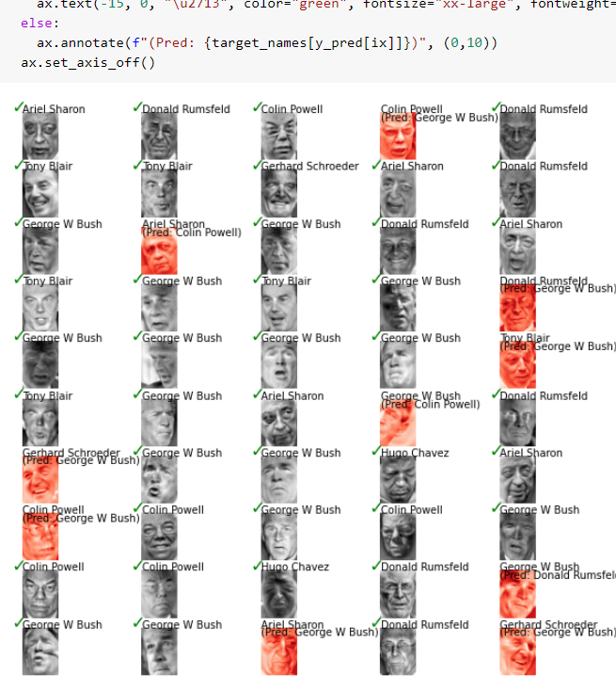
Machine Learning Models?
Credit: Devin Fensterheim

Slide 10
General Classes of ML Models

Slide 11
Types of ML Models?
Regression-based
Linear Regression (Polynomial)
Regularized Regression
K-Nearest Neighbors
Decisions Tree (CART)
SVM
Ada Boost (Ensemble)
Gradient Boosting Method
Random Forest
Extra Trees
Artificial Neural Network
Generalized additive models (NL)
Classification
Logistic Regression
Linear Discriminant Analysis
K-Nearest Neighbors
Decisions Tree (CART)
Support Vector Classifier
Ada Boost (Ensemble Boosting)
Gradient Boosting Method (Ensemble Boosting)
Random Forest (Ensemble Bagging)
Extra Trees (Ensemble Bagging)
Artificial Neural Networks
Recursive Partioning
Classification and Regression Trees (CART)
Conditional Inference Trees (CTREE)
Random Forest Models
Gradient Boost Trees(GBT) /XGBoost/LightGBM
Neural Networks
Artificial Neural Networks
Convolutional Neural Networks
Recurrent Neural Networks
Unsupervised (No labels/outcome variable)
K-Means Clustering
Principle Components Analysis
K-Nearest Neighbors
Ensemble Methods
Random Forest
Voting Classifiers
Ensemble Models
Lasso Regression
Elastic Nets Regression
Splines/MARS (Mixture models)
Naïve Bayes
Gboost/AdaBoost/XGBoost (other Boosting Methods)
Extra trees (Ensemble Bagging)

Slide 12
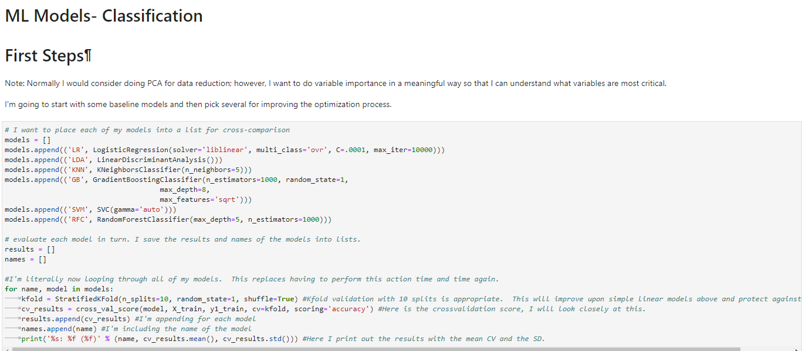
Analyze One Outcome with Many Models
We can join many models together in a single run to discern which have the highest predictive
Accuracy. We can then ensemble strategies through a voting classifier/other process to improve
Prediction and classification.

Slide 13
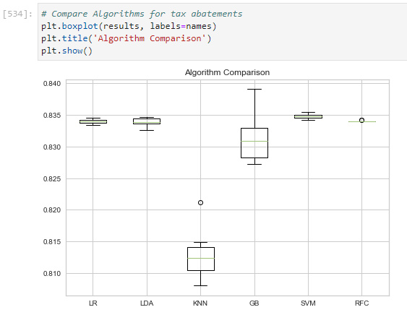
Quickly and Easily Compare Model Performance

Slide 14
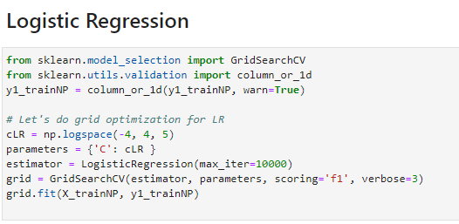
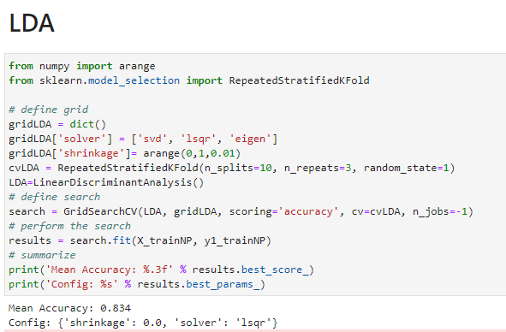
Improve Accuracy with Hyperparameter Tuning

Slide 15
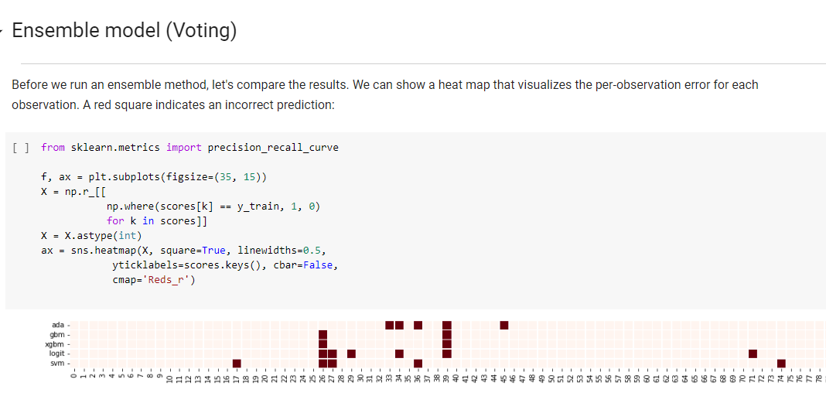
Don’t need to select just one model
Credit: Devin Fensterheim

Slide 16
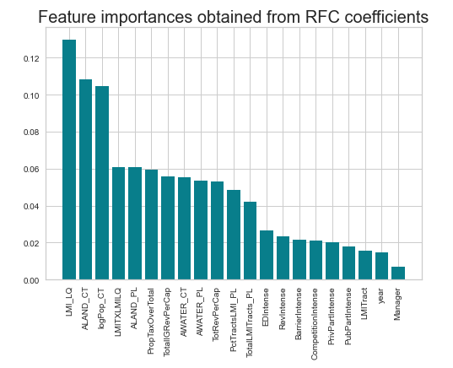
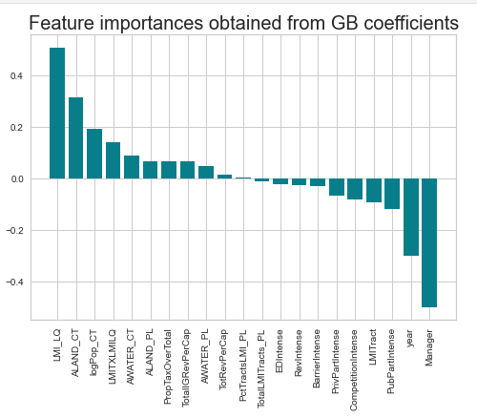
Interpretative Machine Learning: Extract and Compare Feature Importance

Slide 17
New Possibilities in Public Administration Research

Slide 18
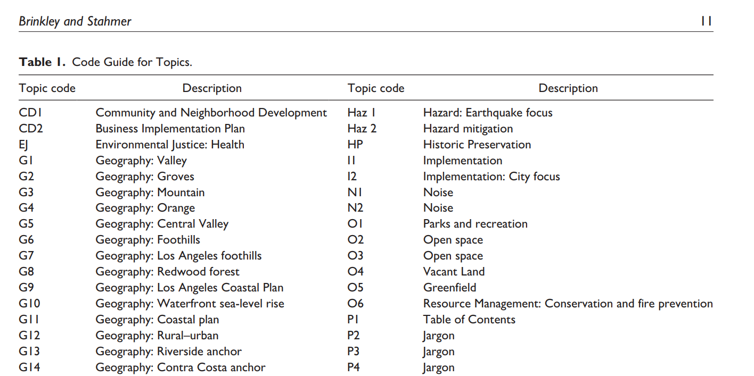
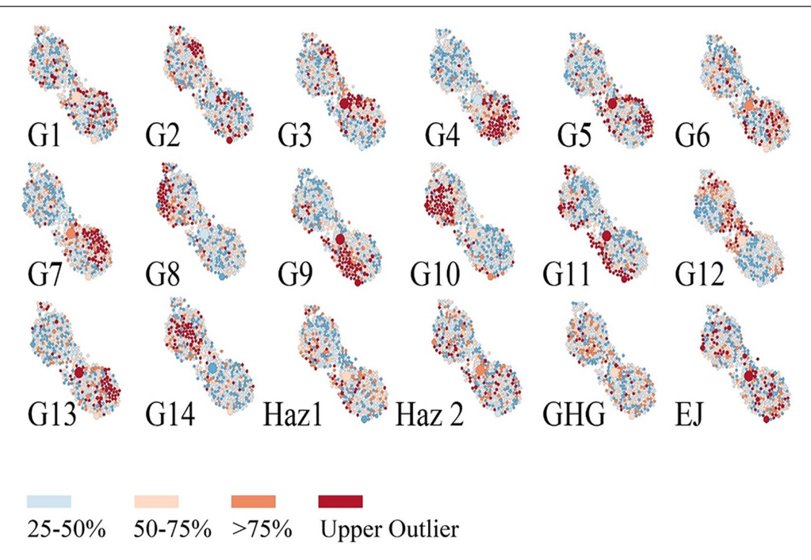
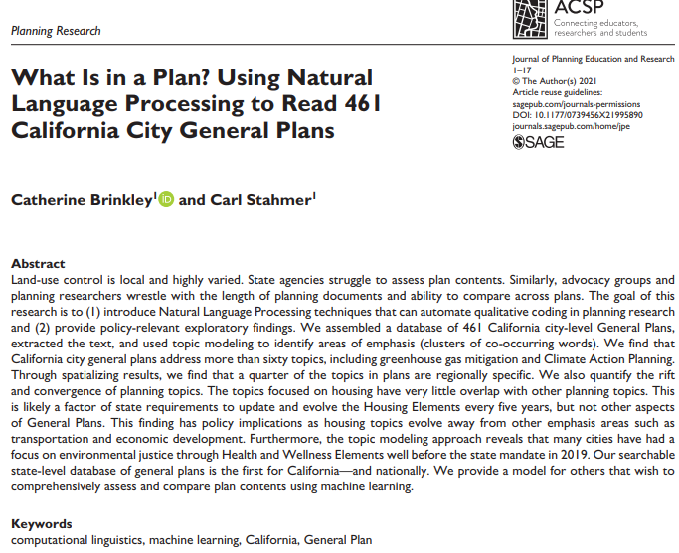
1) Natural Language Processing (i.e. text analytics)
Sentiment analysis (Twitter/FB)
Determine direction of influence (media, politicians, public)
Topic modelling (Legal text)
Text reuse or policy learning (Planning documents)

Slide 19
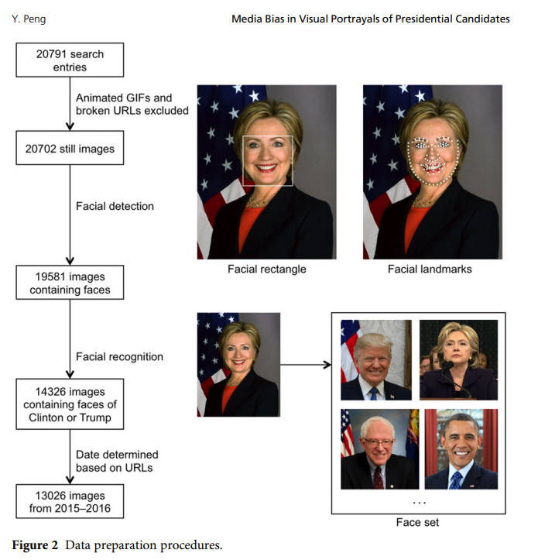
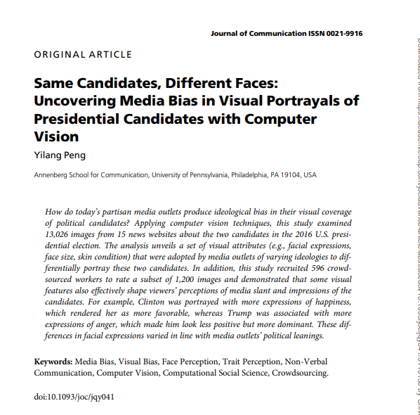
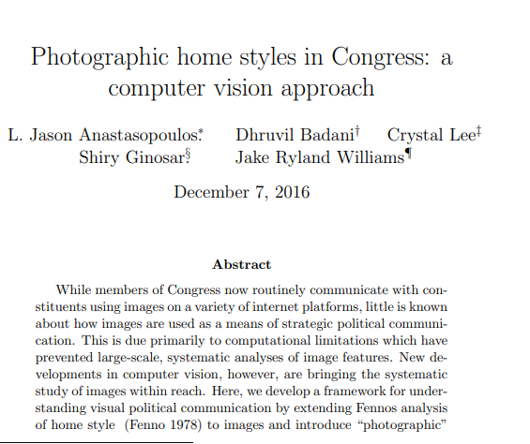
2) Image/Sound/Video Data
Satellite images
Fine-grained facial gestures in campaigns
Visual cues on audience social media engagement

Slide 20
Improve Upon Existing Research Methods: What benefits do you see with ML?

Slide 21
Improve prediction
Examples:
Leading indicators of gentrification/displacement
Predicting public manager performance
Predicting age/gender through social networks
Improve classification
Examples:
Identifying politician ideology
Public service personality traits
Improve causal inference estimators
Blocking algorithms for balancing of groups in experiments
Use prediction to determine realistic comparison groups
Reduce likelihood of p-hacking
LASSO regression penalty
Model heterogenous treatment effects (Grimmer et al. 2021)
Methods: Tree/Bayesian Additive Regression Trees (BART) models
Ensemble Models
Wisdom of the crowds approach to modelling
further predictive improvement by joining models.
Modelling nonlinearities
Tree-based methods
Other ML Approaches
Capable of Handling Complex Data Structures
Geographic Data
Social Networks
Multilevel/Hierarchical Data

Slide 22
One More Benefit: Productizing Models for Practice

Slide 23
Productizing Models for Practice
Not easy…
Paper sought to predict police “adverse incidents” across departments.

Slide 24
Resources to Get Started
Visit: www.ericjstokan.com

Slide 25
Software and Packages

Slide 26
Python Packages
 | General Packages- Data Analytics |  |  |  |  |  |  |  |  | Other
 |  | Pandas |  |  |  |  |  |  |  |  | caffee
 |  | Numpy |  |  |  |  |  |  |  |  | NetworkX
 | Text Analytics
 |  | textcleaner |  |  |  |  |  |  |  | Visuals
 |  | tm |  |  |  |  |  |  |  |  | seaborn
 |  | tweepy |  |  |  |  |  |  |  |  | pandas.plotting
 | ML Basics
 |  | sklearn
 |  |  | Preprocessing |  |  |  |  |  | Classification Models
 |  |  |  | sklearn.model_selection - train_test_split |  |  |  |  |  | sklearn.svm - SVC
 |  |  |  | sklearn.preprocessing - StandardScaler |  |  |  |  |  | sklearn.svm - LinearSVC
 |  |  |  | sklearn.pipeline - Pipeline |  |  |  |  |  | sklearn.linear_model LogisticRegression
 |  |  |  | sklearn.preprocessing - LabelEncoder |  |  |  |  |  | sklearn.ensemble - GradientBoostingClassifier
 |  |  |  | pandas.plotting scatter_matrix |  |  |  |  |  | sklearn.tree - DecisionTreeClassifier
 |  |  |  | category_encoders |  |  |  |  |  | sklearn.neighbors - KNeighborsClassifier
 |  |  | Hyperparamater Optimization |  |  |  |  |  |  | sklearn.discriminant_analysis - LinearDiscriminantAnalysis
 |  |  |  | sklearn.model_selection - GridSearchCV |  |  |  |  |  | sklearn.ensemble - RandomForestClassifier
 |  |  |  | sklearn.model_selection - GridSearchCV |  |  |  |  | Regression Models
 |  |  | Cross-Validation |  |  |  |  |  |  | sklearn.linear_model LinearRegression
 |  |  |  | sklearn.model_selection - StratifiedKFold |  |  |  |  |  | sklearn.ensemble - RandomForestRegressor
 |  |  |  | sklearn.model_selection - RepeatedKFold |  |  |  |  |  | xgboost - XGBRegressor
 |  |  |  | sklearn.model_selection - cross_val_score |  |  |  |  | Neural Networks
 |  |  | Model Evaluation |  |  |  |  |  |  | keras.wrappers.scikit_learn - KerasClassifier
 |  |  |  | sklearn.metrics - mean_squared_error |  |  |  |  |  | keras.utils - np_utils
 |  |  |  | sklearn.metrics - r2_score |  |  |  |  |  | keras.models - Sequential
 |  |  |  |  |  |  |  |  |  | keras.layers - Dense, Dropout
 |  |  |  |  |  |  |  |  |  | keras.callbacks - EarlyStopping

Slide 27
R
 | General Packages- Data Analytics |  |  | Sentiment analyzer
 |  | Tidyverse |  |  | sentimentr
 |  |  |  |  | vader
 | Causal Analytics with ML
 |  | Adaptive LASSO |  | ML Models
 |  |  |  |  | caret
 | Text Analytics |  |  |  | XGBOOST
 |  | textcleaner
 |  | tm
 |  | caret
 |  | topicmodels
 |  | quanteda
 |  | rtweet
 |  | tidytext
 |  | stopwords

Slide 28
Foundation Articles
Statistical Modeling: The Two Cultures
Leo Brieman (2001) (Paper)
Machine Learning Methods Economics Should Know About
Athey and Imbens (2019) (Paper)
Machine Learning: An Applied Econometric Approach
Mullainathan and Spiess (2017)(Paper)
Machine Learning for PA Research: With Applications to Organizational Research
Anastasopopolous and Whitford (2019) (Paper)
Tree-Based Methods for Political Science Data (2017)
Montgomery and Olivella (2017) (Paper)

Slide 29
Computer Vision and Text Analytics
Scrape Local Government Websites to Extract Ideology
Neumann, Linder, and Desmarsais (2021) (Paper)
Understanding the Political Ideology of Legislators from Social Media Images
Xi et al. (2020) (Paper)
Photographic home styles in Congress: a computer vision approach
Anastasopoulos et al. (2016) (Paper)
Same Candidates, Different Faces: Uncovering Media Bias in Visual Portrayals of Presidential Candidates with Computer Vision
Peng et al. (2018) (Paper)
Characterizing twitter user topics and communication network dynamics of the “Liberate” movement during COVID-19 using unsupervised machine learning and social network analysis
Haupt et al. (2021) (Paper)

Slide 30
Predictions with ML
Characterizing twitter user topics and communication network dynamics of the “Liberate” movement during COVID-19 using unsupervised machine learning and social network analysis
Haupt et al. (2021) (Paper)
Predicting User Age, Gender, and University Status by Social Network Information
Ding et al. (2016) (Paper)
Monitoring streets through tweets: Using user-generated geographic information to predict gentrification and displacement
Chapple et al. (2022) (Paper)

Slide 31
Improve Causal Inference/Heterogeneity
Estimating Heterogeneous Treatment Effects and the Effects of Heterogeneous Treatments with Ensemble Methods
Grimmer, Messing, and Westwood (2017) (Paper)
Matching with Text Data: An Experimental Evaluation of Methods for Matching Documents and of Measuring Match Quality
Mozer et al. (2019) (Paper)
Using Machine Learning to Uncover Hidden Heterogeneities in Survey Data
Ramirez et al. (2021) (Paper)
Covariate Adjustment in Regression Discontinuity Designs
Cattaneo et al. (2021) (Paper)

Slide 32
Applications: Budgets, Plans, Official Docs
Organizational Context and Budget Orientations: A Computation Text Analysis
Anastasopoulos, Moldogaziev, and Scott (2020) (Paper)
What Is in a Plan? Using Natural Language Processing to Read 461 California City General Plans
Brinkley and Stahmer (2021) (Paper)
Contracting in Brazilian public administration: A machine learning approach
Henrique et al. (2017) (Paper)
Public administration, public leadership and the construction of public value in the age of the algorithm and ‘big data’
Andrews (2017 (Paper)

Slide 33
Other Applications- Social Network Analysis
Machine Learning for Social Network Analysis: A Systematic Literature Review (2012)
De et al. (2012) (Paper)
Predicting User Age, Gender, and University Status by Social Network Information
Ding et al. (2016) (Paper)
Combining Machine Learning and Social Networks to Reveal the Organizational Structure
Nurek and Michalski (2020) (Paper)

Slide 34
Some Differences Between Approaches

Slide 35
Data Science v. Traditional Research Approaches
Algorithmic v. Modelling Approach (See Breiman, 2001)
Terminology
Target variables= Dependent/Outcome Variables
Features= Independent/Control Variables
Different Assumptions
We need not transform data to make it strictly linear and additive.
Not a fundamental violation of assumptions with high multicollinearity (less efficient computationally)
Feature Importance does not equal parameter estimates (Includes nonlinear/multidimensional effects)
Process for models
Consideration of training/validation/testing samples
Hyperparameter searching (i.e. learning rates, # of iterations, # of neurons, etc.)
Model selection processes or ensembling
Decisions on what to optimize on (type of performance metrics)
Selection of final models (or ensemble methods)

